Slide 1
Theory of Mind Models for Inference and Prediction of Tactical Agents in Naval Operations
Nigel Doering
Basic Research Proposal

Slide 2
Problem Context
Inferring blue and red agent cognitive states is critical to answer meaningful questions:
Where is this red/blue agent going?
Why are they going there? What is the goal?
What route might they take?
Why did they change directions?
Is the environment different from what we expected based on their actions?
In general, what are agents “thinking” and how can we predict what they are thinking from limited available information?

Slide 3
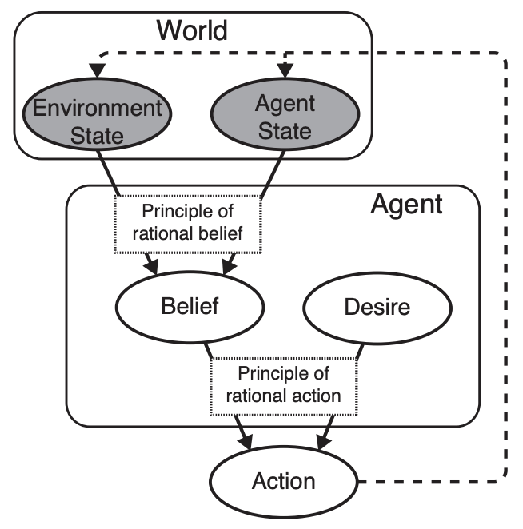
Theory of Mind
Def: The human capacity for reasoning about agents’ mental states such as beliefs and desires.
Causal structure can be represented graphically:
Human agents are rational planners who generally hold rational beliefs
They will act in their best interest to achieve their desire
Humans naturally develop theories of other agents’ minds
Image from Bayesian Theory of Mind: Modeling Joint Belief-Desire Attribution. Baker et al.

Slide 4
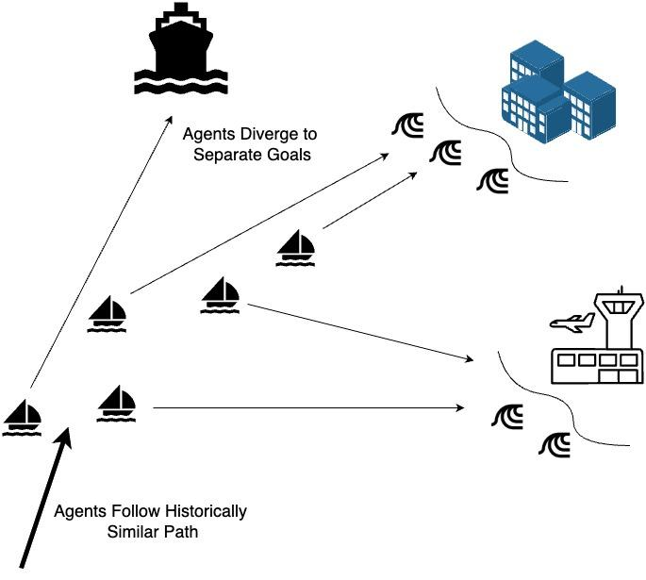
Naval Operations Example
We observe multiple red agents in an area.
How can we learn:
What are they doing?
What do they plan to do?
What is their goal?
Improves decision making
Earlier and quicker response
Naturally interpretable probabilities

Slide 5

A More Relevant Example
Frame 5
Frame 10
Red Forces
Past Movements
Red Forces
Past Movements
We want to know the probability that an agent's goal is reach Taipei, i.e. P(goal=Taipei | previous movements)
At frame 5: probability is low
At frame 10: probability is high
We can build automated early warning models for agent mental states such as goals

Slide 6
A More Relevant Example
Can use model for any agent in given environment
Goals:
Track red forces
Learn a theory of mind model
Infer:
Goals
Beliefs
Intent
Red Forces

Slide 7
Bayesian Theory of Mind Examples
These mental states can be modeled naturally as bayesian probabilistic models. From the example: a=action, o=observation, g=goals, x=location
Inference can be done by finding the posterior such as:
P(goal = y | past actions, past locations) = P(past actions, past locations | goal = y) P(goal = y)
Can be considered a Partially Observable Markov Decision Process
Other papers present similar modeling techniques
Goal Inference as Inverse Planning (Baker et al.)
Inferring the Intentional States of Autonomous Virtual Agents (Pantelis et al.)
Just to say, this is an active area of research

Slide 8
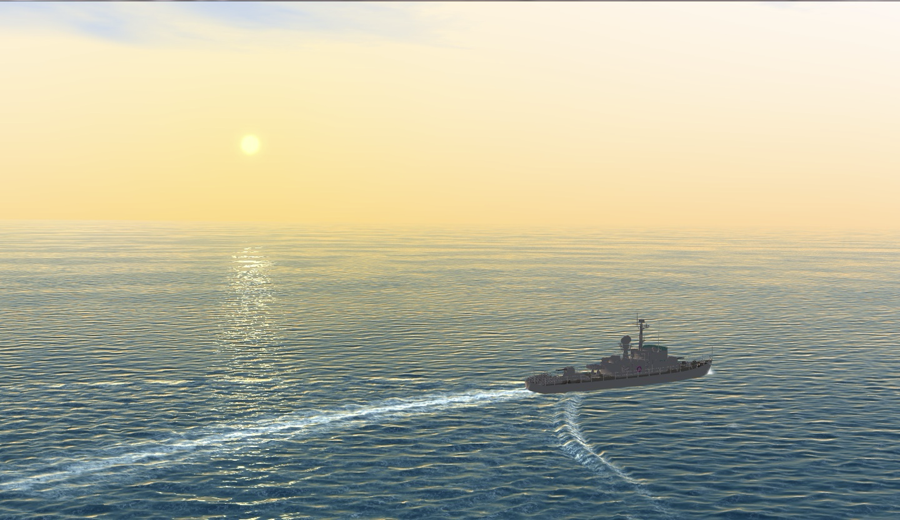
A Simulation First Approach
We can simulate different scenarios with sensor data collection using NVIDIA omniverse
We can connect the sensing/perception component to the inference/action component
We “sense” multiple surface drones approaching multiple targets. We “infer” which drone is going to which target

Slide 9
Limitations
The long term goal -- to be able to sense, model, and infer agent mental states in the real world -- involves very large probability spaces.
The space of possible actions in the ocean is immense
Similar with flight
However, talking with domain experts, we can constrain the problem spaces to more reasonable size
Can learn what is very unlikely/doesn’t make sense
The initial research will study simpler examples
First, a simulation approach followed by testing of remote controlled agents

Slide 10
Questions
Are my use cases/examples relevant?
What might be a compelling story?
Is this basic research?
Recommendations?

Slide 11
Appendix

Slide 12
Omniverse Simulation
Omniverse is a simulation tool used primarily for digital twins and robot learning “model pretraining”
Contains built in sensor integration for RGB, event, lidar, and more.
Can design custom agents, like drones, using Blender software
Python backend for experimentation
Generally, we can create any scenario we would like and use for pretraining data
Not a replacement for real world data

Slide 13
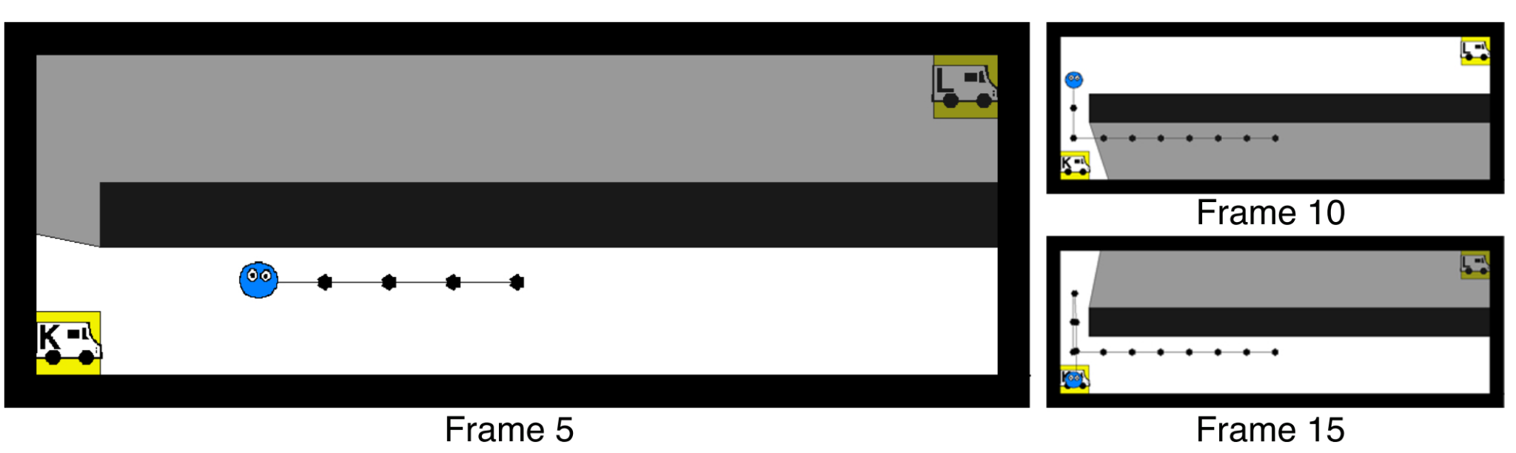
Theory of Mind Practical Example
At frame 5, the student walks towards truck K
At frame 10, the student passes K and walks towards the other parking spot and observes food truck L
At frame 15, the student turns around and goes to food truck K.
What can we infer of the student’s desires?
Image from Bayesian Theory of Mind: Modeling Joint Belief-Desire Attribution. Baker et al.

Slide 14
Theory of Mind Practical Example
You have some data of the below environment including: (1) A map; (2) Tracking data of a student (blue); (3) two parking spots for food trucks; and (4) three food trucks that visit L, M, and K. Based on the student’s tracks, can we infer which food they want?
Image from Bayesian Theory of Mind: Modeling Joint Belief-Desire Attribution. Baker et al.

